Slide 1
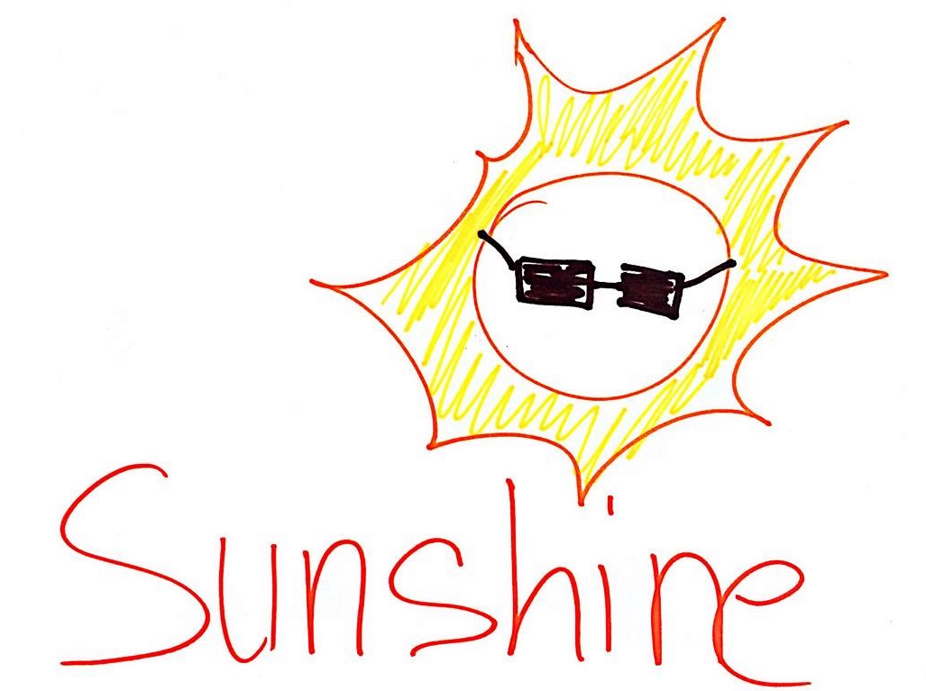
Sunshine Dapp – science validated skin health

Slide 2
Sunshine - self monitoring skin cancer D-App that supports individuals, GPs and Outpatients clinics make evidence validated decisions.
Problem: demand, accurate referrals, quality of clinician decision
Wins: meet the demand, accuracy of referrals, quality of decision making, reduce costs and benefits
solution: self monitoring, more data!

Slide 3
Patient
Mole Picture
NHS Data
Extra Factors
ML
Request extra permission
GP
Request extra permission
Clinician

